Slide 1
Introduction to Data Communications (CMP 206)
Compiled by
Egena Onu, Ph.D.

Slide 2
Network Topologies
A network topology is the arrangement in which network devices and user devices are connected.
Topology may define both physical and logical aspect of the network.
Both logical and physical topologies could be same or different in the same network.
Network topologies include:

Slide 3
Network Topologies
Point-to-Point
In point-to-point networks, two host are directly connected to each other.
These host could be computers, switches, routers, or servers that are connected back to back using a single cable.
In any case, the receiving end is connected to the sending end or vice versa. If the hosts are connected point-to-point logically, then they may have multiple intermediate devices.
In logical connections, the end hosts are unaware of the underlying network and see each other as though they are directly connected.

Slide 4

Network Topologies
Point-to-Point

Slide 5
Network Topologies
Bus Topology
In bus topology, all the devices share a single communication line/cable.
CSMA/CD technology is essential to bus topology because multiple hosts may send data at the same time.
Other than CSMA/CD, the hosts on the network may recognise one host as the bus master.
This topology is a simple form of networking in which the failure of a device does not affect the others.
However, failure of the shared medium affects all the devices.
Both ends of the shared medium have a line terminator.
Data sent in only one direction and gets terminated when it reaches the extreme end.

Slide 6
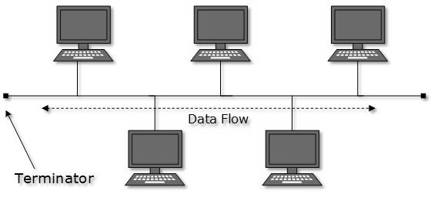
Network Topologies
Bus Topology

Slide 7
Network Topologies
Star Topology
In this topology, all the hosts are connected to a central device known as the hub.
Host to hub connection is achieved using a point-to-connection.
The hub device can be a:
Layer 1 device such as a hub or a repeater.
Layer-2 device such as a switch or a bridge.
Layer-3 device such as a router or a gateway.

Slide 8
Network Topologies
Star Topology
In this topology, the hub is a single point of failure.
If the hub fails, connectivity fails, consequentially.
Communication between hosts takes place through the hub.

Slide 9
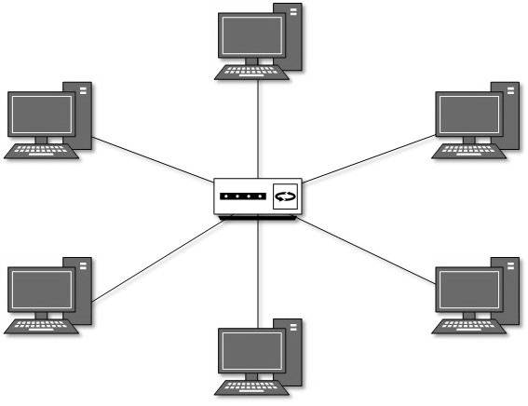
Network Topologies
Star Topology

Slide 10
Network Topologies
Ring Topology
In this topology, each system connects exactly to other system to create a circular structure.
When a system communicates to another, the data goes through all intermediate systems.
Connecting a new system in this topology requires just one cable.
A failure of one host results in the failure of the entire network.
However, a backup ring may be implemented to counter such failure.

Slide 11
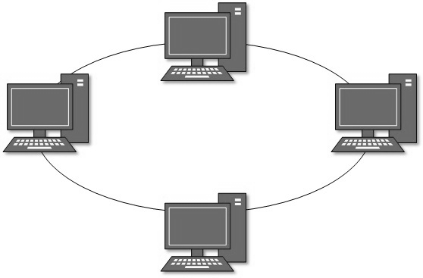
Network Topologies
Ring Topology

Slide 12
Network Topologies
Mesh Topology
In mesh topology, a host is connected to one or multiple hosts.
The topology utilises point-to-point connection to connect hosts.
Hosts in mesh topology may work as relay for other hosts which do not have direct point-to-point links.
Mesh topology includes:
Full Mesh:
All hosts have a point-to-point connection to every other host in the network.
For every new host, n(n-1)/2 connections are required.
This topology provides the most reliable network structure among all network topologies.

Slide 13
Network Topologies
Mesh Topology
Partially Mesh:
In partially mesh topology, some hosts do not have a point-to-point connection to every other host.
Hosts connect to each other in some arbitrarily fashion.
This topology exists where there is need to provide reliability to some hosts out of all.

Slide 14
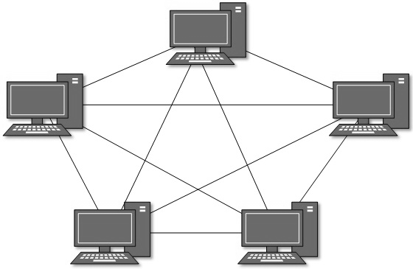
Network Topologies
Mesh Topology

Slide 15
Network Topologies
Tree/Hierarchical Topology
This is the most common form of network today.
The topology imitates as extended star topology with inherited properties of the bus topology.
This topology divides the network into multiple levels/layers of network.
In LANs, this topology categorises network devices into three types:
The lowermost is the access layer where computers are attached.
The middle layer is referred to as the distribution layer and works the mediator between the upper and lower layers.
The topmost layer is the core layer, and the central point of the network, i.e. root of the three from which all nodes forks out.
Notes:
Tree/Hierarchical Topology extends the star topology and inherits the bus topology

Slide 16
Network Topologies
Tree/Hierarchical Topology
In this topology, all neighbouring hosts have a point-to-point connection between them.
Just as in bus topology, if the root goes down, the entire network suffers even though it is not a single point of failure.
Every connection serves as a point of failure. If the connection fails, it divides the network into unreachable segments.

Slide 17
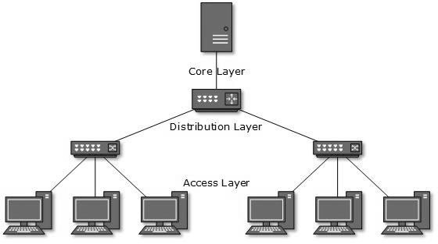
Network Topologies
Tree/Hierarchical Topology

Slide 18
Network Topologies
Daisy Chain Topology
Daisy chain topology connects all the host in a linear fashion.
Just like in ring topology, all hosts are connected to two hosts only except the end hosts.
Each link represents a single point of failure.
Every link failure splits the network into two segments.
An intermediate host works as relay for its immediate hosts.

Slide 19

Network Topologies
Daisy Chain Topology

Slide 20
Network Topologies
Hybrid Topology
Hybrid is a network whose design contains more than one topology.
It inherits the merits and demerits of all the incorporating topologies.
The combining topologies may contain attributes of the different topologies.
Most WANs are connected by means of dual-Ring topology and networks connected to them are star topology networks.
The entire Internet depicts the largest hybrid topology.

Slide 21
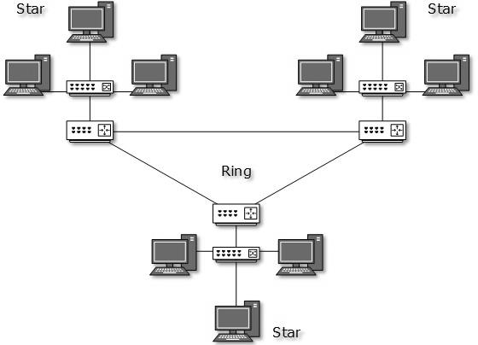
Network Topologies
Hybrid Topology

Slide 22
Network Models
Network engineering is a complicated task that involves software, firmware, chip level engineering, hardware and electric pulses.
To ease network engineering, the whole networking concept is divided into multiple layers.
Each layer is involved in some particular task and is independent of all other layers.
However, almost all networking tasks depend on all layers.
Layers share data between them and the depend on each other only to take input and send output.
In layered architecture of network model, one whole network process is divided into small tasks.
Each small task is then assigned to a particular layer which works dedicatedly to process the task.
Every layer does only specific work.
Notes:
Network Models summarized:
Due to Network engineering being a complicated task the concept of network engineering was subdivided into multiple layers known as Network Models. Where each layer is
independent and performs a particular task. But almost all networking tasks depends on all the layers

Slide 23
Network Models
In a layered communication system, one layer of a host deals with the task done by or to be done by its peer layer at the same level on the remote host.
The task is either initiated by layer at the lowest level or the one at the top most level.
If the task is initiated by the topmost layer, it is passed on to the layer below it for further processing.
lower layer does the same thing. It processes the task and passes on to higher layer.
Every layer clubs together all procedures, protocols, and methods which it requires to execute its piece of task.
All layers identify their counterparts by means of encapsulation header and tail.

Slide 24
Network Models
Open System Interconnect (OSI) Model
The OSI is an open standard for all communication systems.
OSI model is established by the International Standard Organisation.
The OSI model has seven layers:

Slide 25
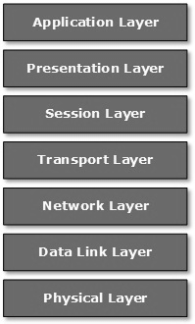
Network Models
Open System Interconnect (OSI) Model

Slide 26
Network Models
Open System Interconnect (OSI) Model
Application Layer:
This layer is responsible for providing interface to the application user.
The layer encompasses protocols which directly interact with the user.
Presentation Layer:
This layer defines how data in the native format of a remote host should be presented in the format of the receiving host.
Notes:
Summary
Application Layer – This layer is responsible for presenting the user with an interface
Presentation Layer – This layer defines how data in the native format of the remote host should be presented in the format of the receiving host
Session Layer – This layer handles session between remote hosts
Transport Layer – This layer maintains end-to-end delivery remote hosts
Network Layer – This layer performs addressing and also unique addressing between hosts
Data Link Layer – This layer is responsible for reading and writing data onto line
Physical Layer – This layer defines the hardware, cabling, wiring, power output, pulse rate, etc.

Slide 27
Network Models
Open System Interconnect (OSI) Model
Session Layer:
The session layer maintains sessions between remote hosts.
For example, once user/password authentication is done, the remote host maintain this session for a while and does not ask for authentication again in that time span.
Transport Layer:
The transport layer is responsible for end-to-end delivery between hosts.
Network Layer:
Network layer performs address assignment and uniquely addressing hosts in a network.

Slide 28
Network Models
Open System Interconnect (OSI) Model
Data Link Layer:
The data link layer is responsible for reading and writing data from and onto the line.
Link errors are also detected on this layer.
Physical Layer:
This layer defines the hardware, cabling, wiring, power output, pulse rate, etc.

Slide 29
Network Models
Internet Model:
The Internet uses Transmission Control Protocol (TCP) and Internet Protocol (IP) protocol suite also known as the Internet suite.
The TCP/IP protocol suite defines the Internet Model which contains four layered architecture.
In spite of the OSI model, the Internet Model is model used for communications on the internet.
The internet is independent of its underlying network architecture just like its model.
Notes:
The Internet Model is a 4 layered architecture model used for communication on the internet

Slide 30
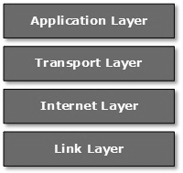
Network Models
Internet Model:

Slide 31
Network Models
Internet Model:
Application Layer
This layer defines the protocols which enables users to interact with the network.
These protocols include FTP, HTTP, etc.
Transport Layer
This layer ensures data flow between hosts.
The major protocol on this layer is the TCP.
This layer ensures that data delivered between hosts are in order.
The transport layer is responsible for end-to-end delivery.
Notes:
Application Layer - This layer defines protocols that enables users to interact with the network. Eg. FTP, HTTP, etc.
Transport Layer - This layer maintains end-to-end delivery remote hosts. e.g. TCP
Internet Layer – This is originally the network layer of the OSI Model and handles addressing between hosts
Link Layer – This layer provides mechanisms for sending data and receiving data and independent of underlying network architecture

Slide 32
Network Models
Internet Model:
Internet Layer
This is originally the network layer of the OSI model and sometimes referred to as the Layer Three.
This layer facilitates host addressing and recognition.
The IP protocol works on this layer.
The Internet layer defines routing in the throughout the entire network.
Link Layer
The link layer provides the mechanism for sending and receiving data on the network.
Unlike its counterpart in the OSI model, this layer is independent of the underlying network architecture and hardware.

Slide 33
Question!!!

